Slide 1
Failure prediction for complex load cases
in sheet metal forming
Project leader
Md Shafiqul Islam, Blekinge Institute of Technology
Project duration
November 2020 – January 2024
Partners
BTH, RISE, Volvo Cars, SSAB, Alfa Laval, Volvo Trucks and Scania
19th March 2024

Slide 2
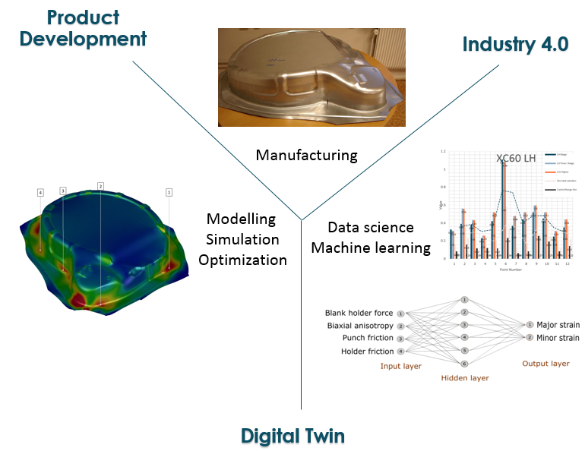
PREDICT Background

Slide 3
Background
Pilthammar, J., et al. 2019. Simulation of sheet metal forming using elastic stamping dies.

Slide 4
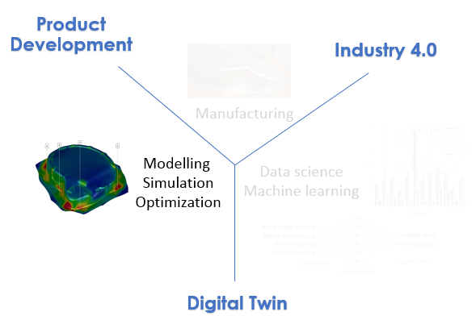
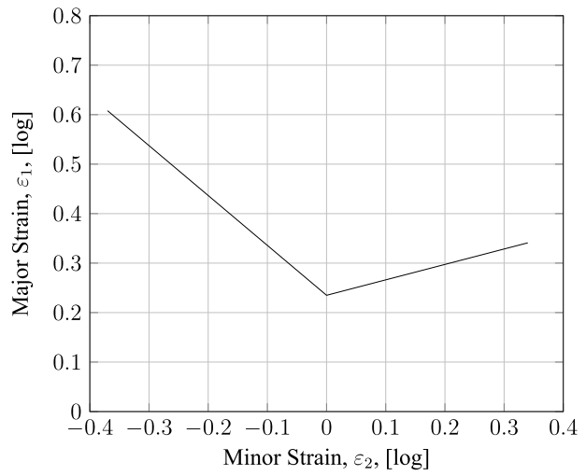
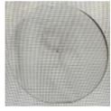
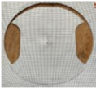
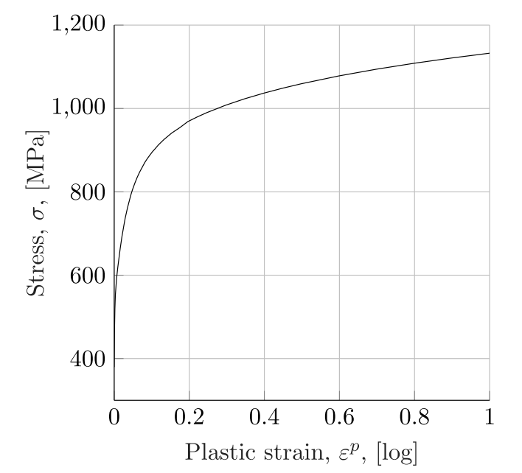
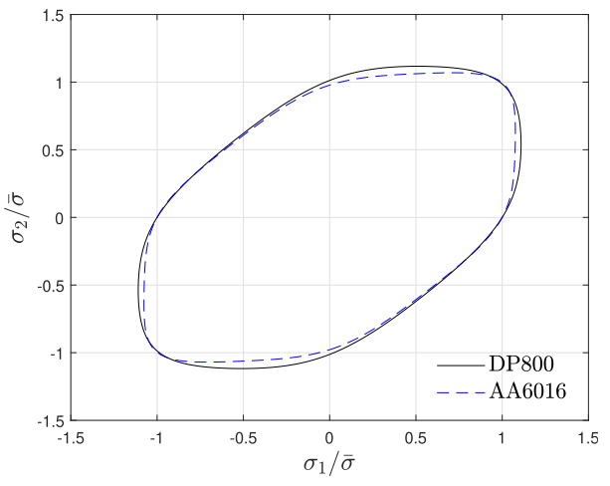
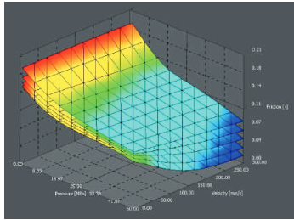
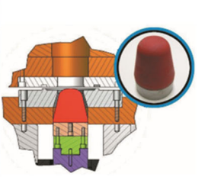
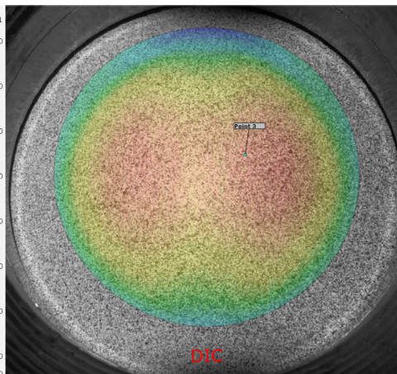
Background
Forming Limit Curve
Hardening
Yield
Tribology
Pérez Caro, L., er al. 2020

Slide 5
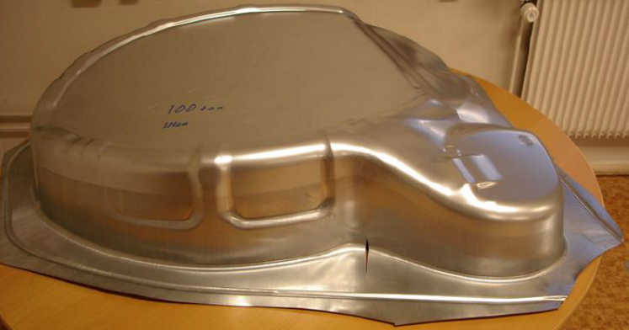
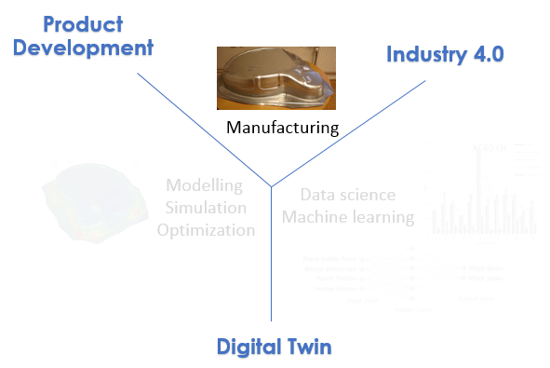
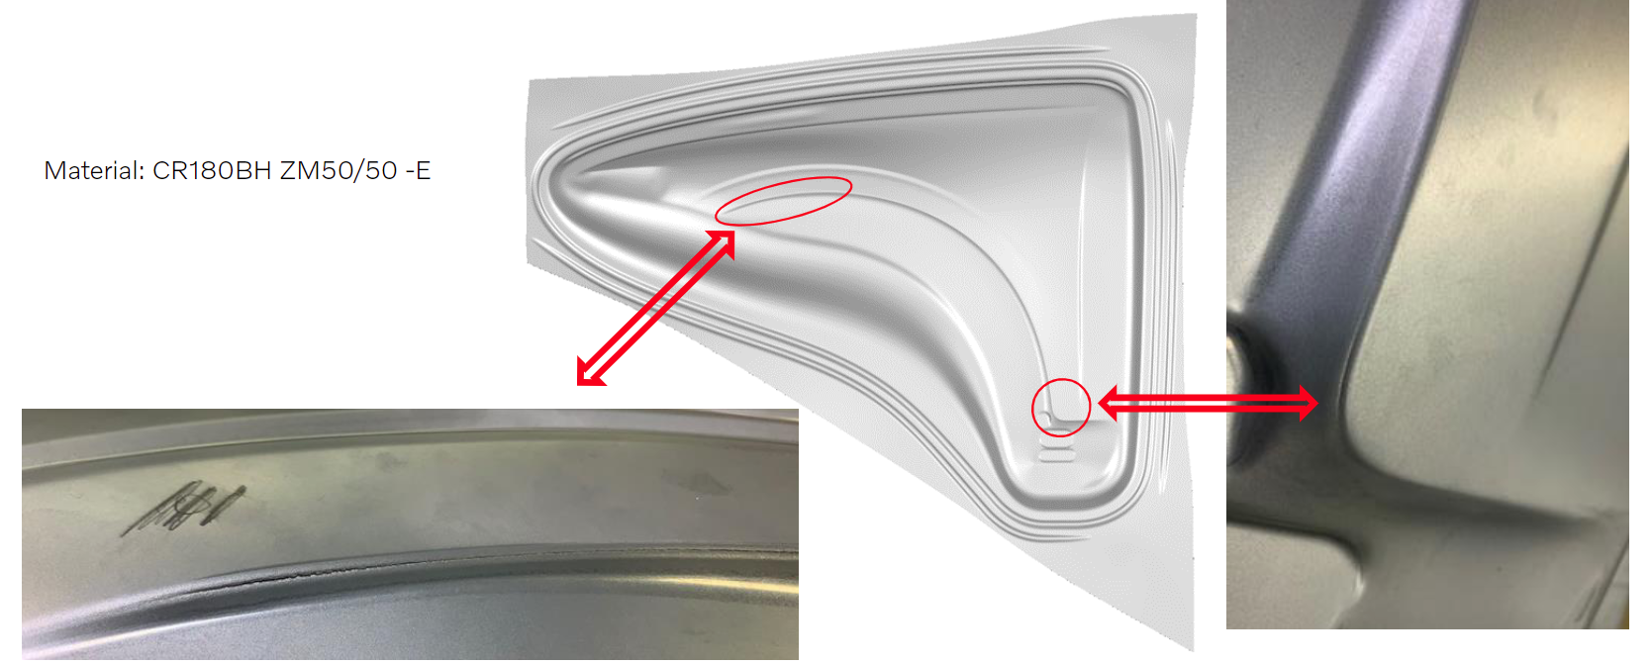
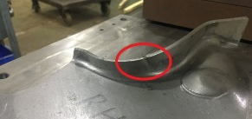
Background
Mild steel
Alloy 316
Non-linear strain paths
Example: Complex Load Cases
CR180BH
Stretch-bending at small radii
HSS
Edge cracks

Slide 6
Objective of PREDICT
Achieve increased accuracy in failure predictions by developing advanced material models, calibration techniques and effective FE-simulations, which can enable unambiguous and reliable forming limit predictions.
PREDICT process adjustment to prevent failure in a formed part as a result of material parameter variation.
Three failure effecting phenomena are studied experimentally and incorporated in FE-models:
Non-linear strain paths
Combined bending and stretching
Edge cracks

Slide 7
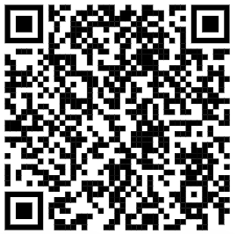
Non-linear Strains Effect of Formability
Results in publications

Slide 8
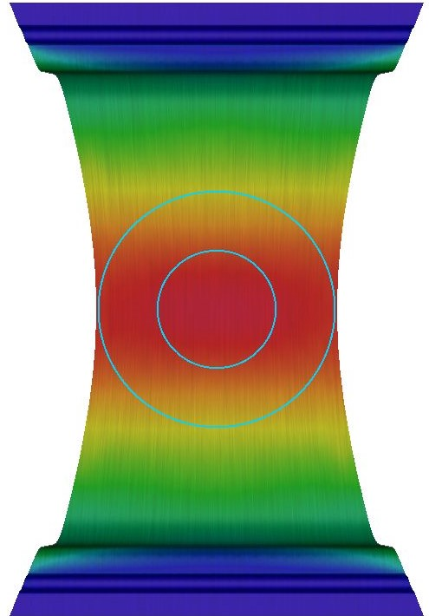
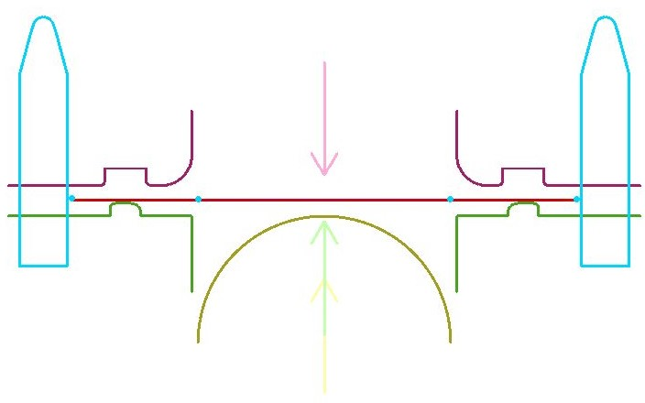
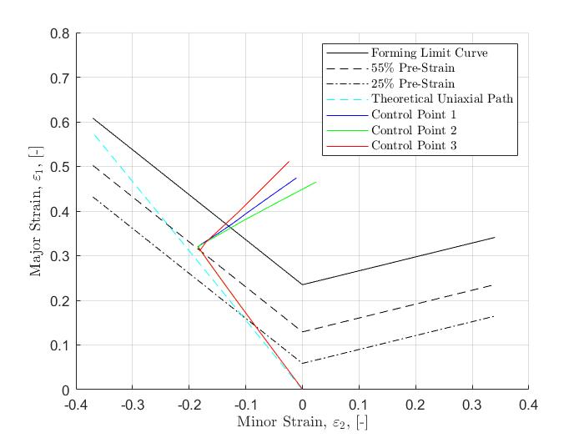
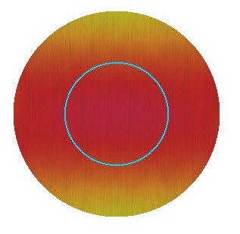
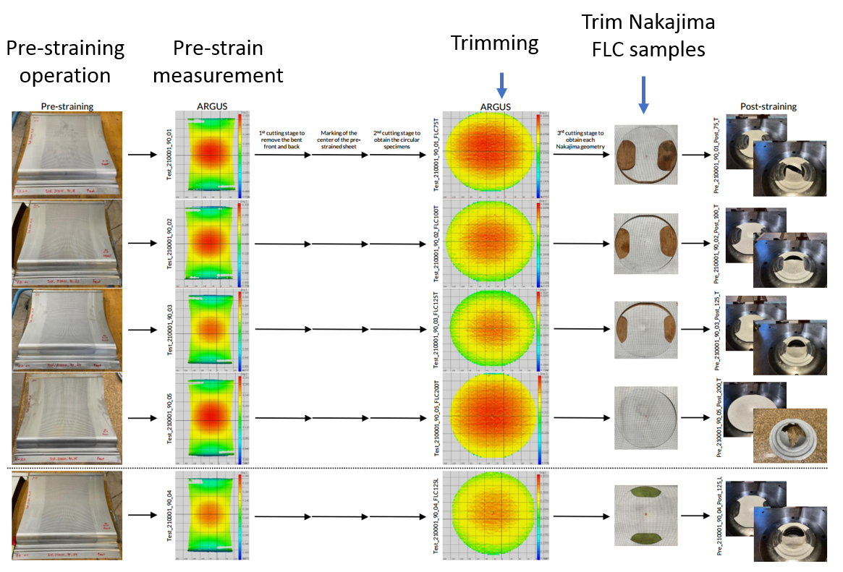
Non-linear Strains Effect of Formability
350 mm
Pilots
530 mm
Trimming
Operation
Nakajima
Biaxial
Die
Blank
Blankholder
Punch
Pre-strain operation
Trim operation
Post-strain operation

Slide 9
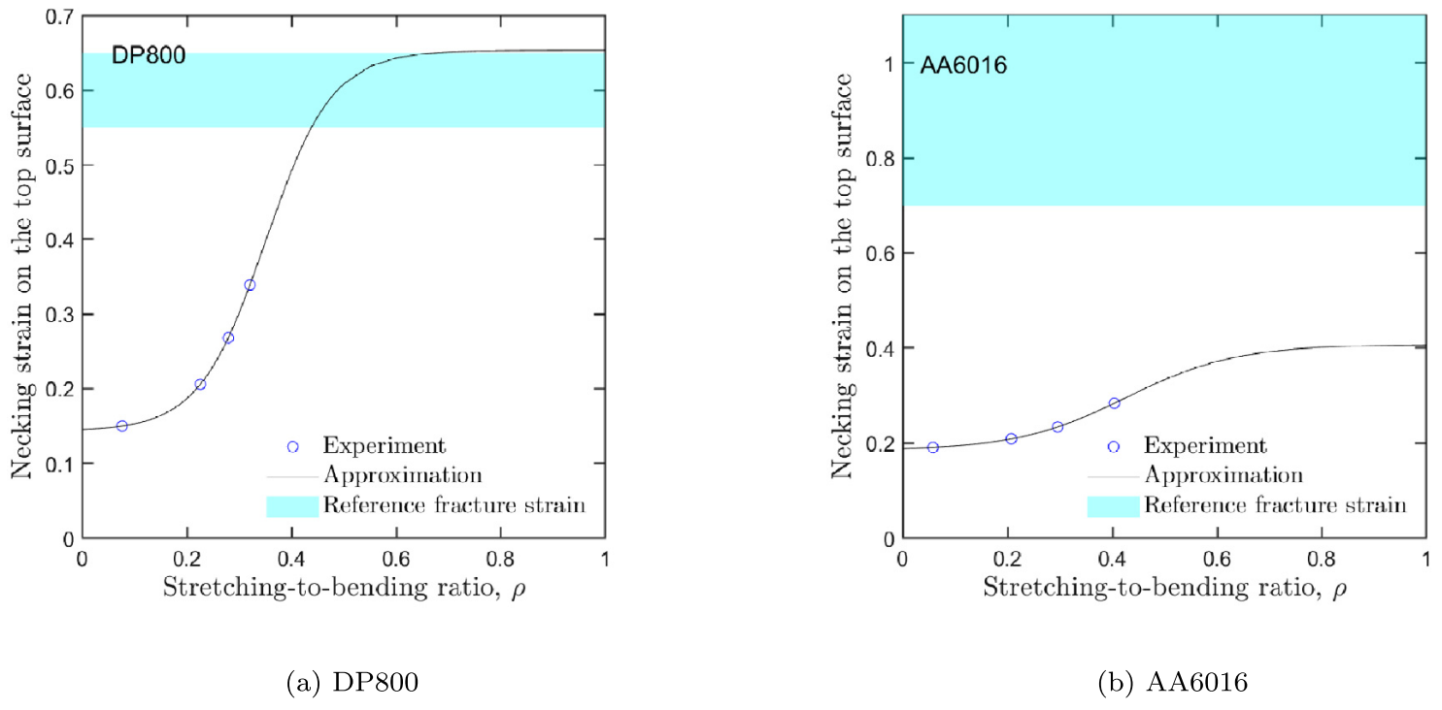
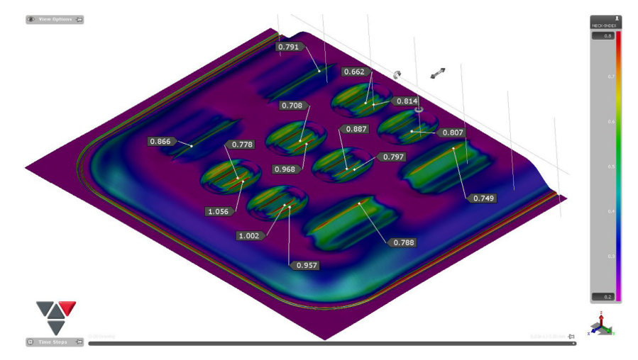
Combined-load Effect on Formability
Stretch-bending
Results in publications

Slide 10
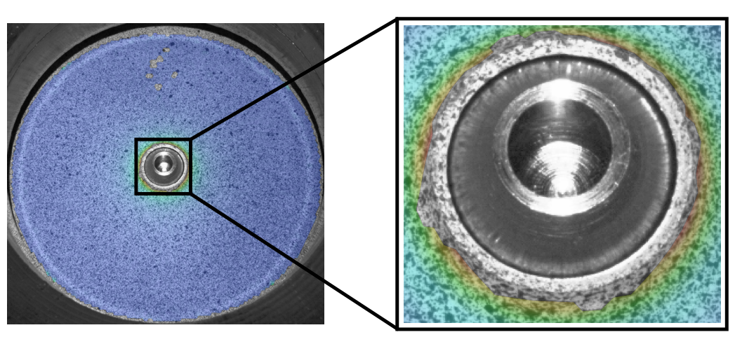
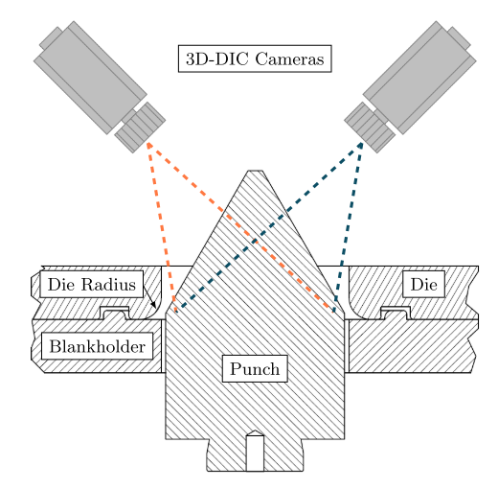
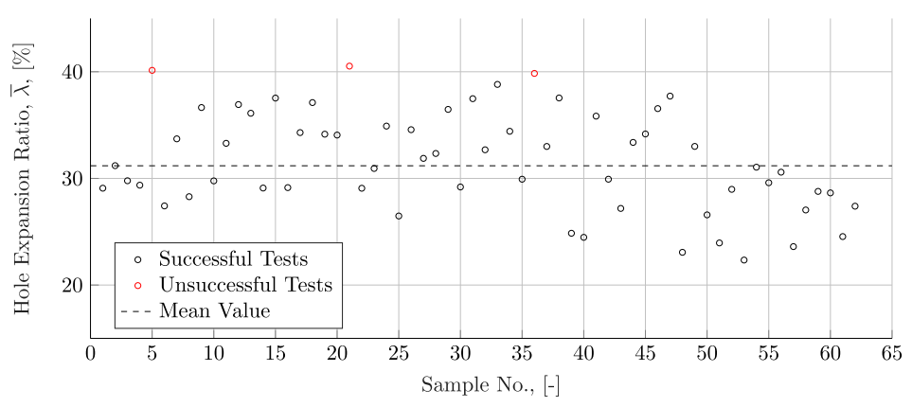
Edge Formability
Hole Expansion Test
Edge crack
Hole Expansion Ratio

Slide 11
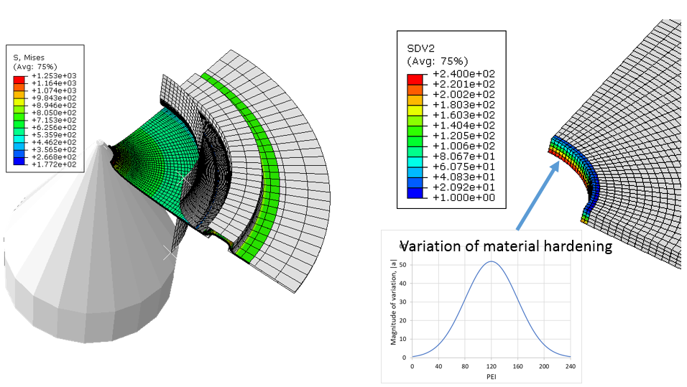
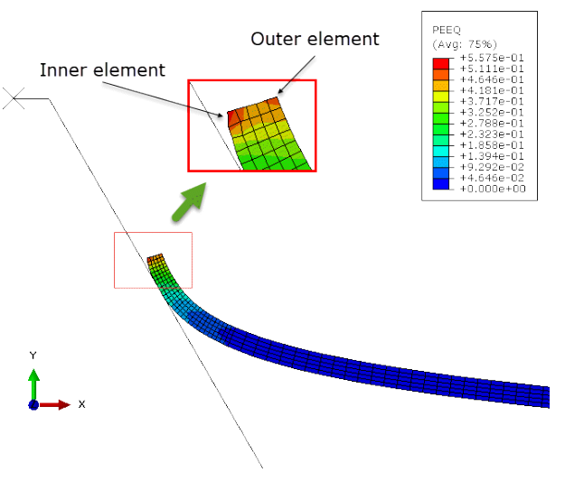
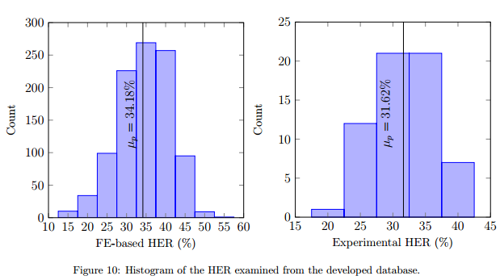
Edge Formability
3D model
Results in publications
Simulated Hole Expansion Test
Successfully simulated effect of variations
2D model

Slide 12
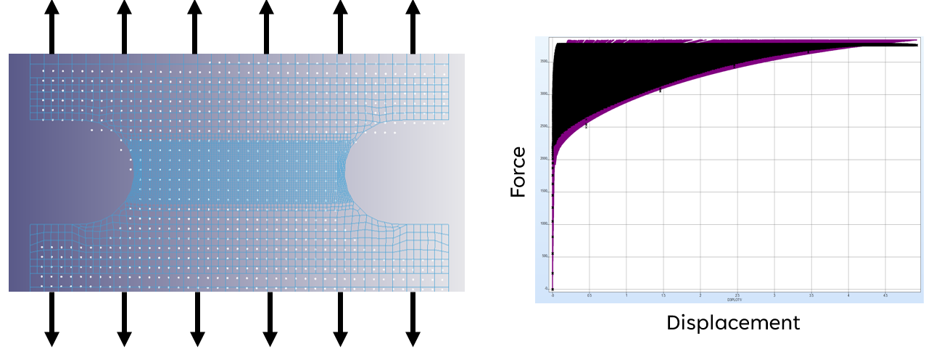
Advanced Material Calibration
Proposal of failure prediction and detection methods:
MMFC2
Coefficient of Variation
Full deformation field optimization
Results in publications
Advance test methods

Slide 13
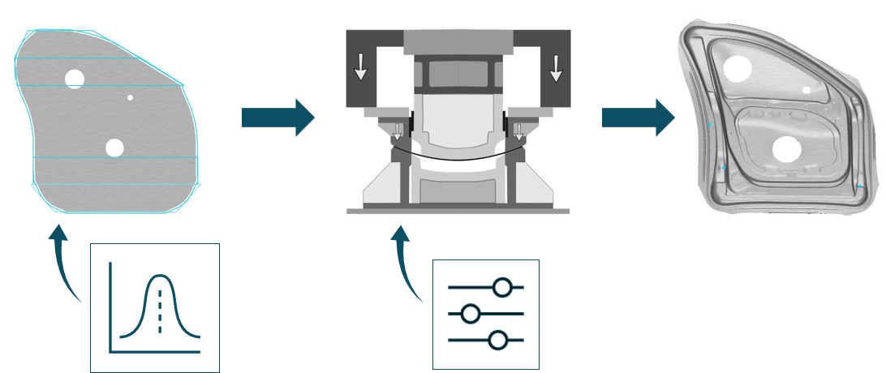
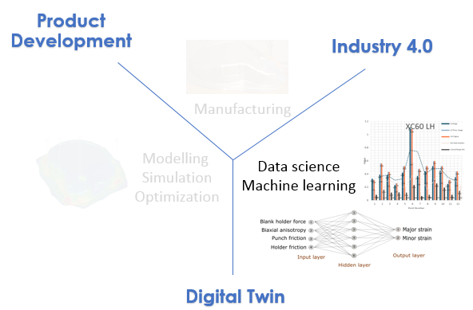
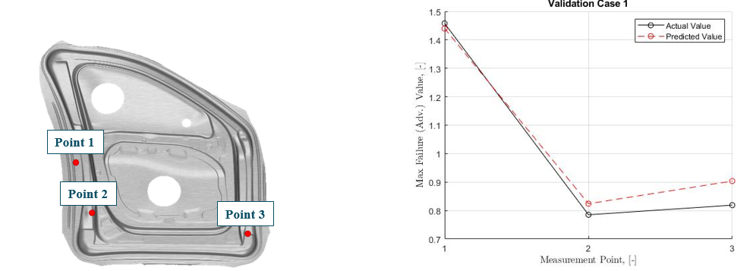
Industry 4.0
Variation in Material Process

Slide 14
Publications
C1: Barlo, A., Sigvant, M., Pérez, L., Islam, M. S., & Pilthammar, J. (2022, May). A Study of the Boundary Conditions in the ISO-16630 Hole Expansion Test. In IOP Conference Series: Materials Science and Engineering (Vol. 1238, No. 1, p. 012031). IOP Publishing.
C2: Barlo, A., Sigvant, M., Manopulo, N., Islam, M. S., & Pilthammar, J. (2022). Failure prediction of automotive components utilizing a path independent forming limit criterion. Key Engineering Materials, 926, 906-916.
C3: Tuan Pham, Quoc, Md Shafiqul Islam, Mats Sigvant, and Perez Lluis Caro. "Prediction of forming limit diagram of automotive sheet metals using a new necking criterion." In International ESAFORM Conference 2023, pp. 705-710. 2023.
C4: Pham, Q. T., Islam, M. S., Barlo, A., & Sigvant, M. (2023, June). An evaluation method for experimental necking detection of automotive sheet metals. In IOP Conference Series: Materials Science and Engineering (Vol. 1284, No. 1, p. 012020). IOP Publishing.
C5: Barlo, A., Sigvant, M., Kesti, V., Islam, M. S., Pham, Q. T., & Pilthammar, J. (2023, June). Determination of Edge Fracture Limit Strain for AHSS in the ISO-16630 Hole Expansion Test. In IOP Conference Series: Materials Science and Engineering (Vol. 1284, No. 1, p. 012027). IOP Publishing.
C6: Barlo, A., Sigvant, M., Islam, M. S., Pérez, L., Olofsson, E., Al-Fadhli, M., ... & Odenberger, E. L. (2023, June). Proposal of a New Tool for Pre-Straining Operations of Sheet Metals and an Initial Investigation of CR4 Mild Steel Formability. In IOP Conference Series: Materials Science and Engineering (Vol. 1284, No. 1, p. 012079). IOP Publishing.
J1: Pham, Q. T., Islam, M. S., Sigvant, M., Caro, L. P., Lee, M. G., & Kim, Y. S. (2023). Improvement of modified maximum force criterion for forming limit diagram prediction of sheet metal. International Journal of Solids and Structures, 273, 112264.
J2: Pham, Q. T., Islam, M. S., Barlo, A., Sigvant, M., Caro, L. P., & Trana, K. (2023). Modeling the strain localization of shell elements subjected to combined stretch–bend loads: Application on automotive sheet metal stamping simulations. Thin-walled structures, 188, 110804.
J3: Uncertainty quantification for conical hole expansion test of DP800 sheet metal (Submitted for Journal publication)
L1: Barlo, A. (2023). Failure Prediction of Complex Load Cases in Sheet Metal Forming: Emphasis on Non-Linear Strain Paths, Stretch-Bending and Edge Effects (Licenciate dissertation, Blekinge Tekniska Högskola).
Publication list

Slide 15
Conclusions and Outlook
The studies showed that studied complex load cases significantly affect the formability in sheet metals hence failure.
PREDICT has increased accuracy in failure prediction by developing advanced formability evaluation methods, calibration techniques and effective FE-models for simulations.
FE-simulation and measurement data-based meta-models can be used for quality assurance in the sheet metal forming process.
AI-based process adjustment applications can be developed and associated with press lines to check the effectiveness of the developed meta-model in actual production.
Material testing 2.0 (MT2.0) can be further studied for simplifying yield criteria and FLC determination.
Stochastic modeling of uncertainty quantification showed great possibility of doing non-deterministic FE-modeling of forming deformations in the future.

Slide 16
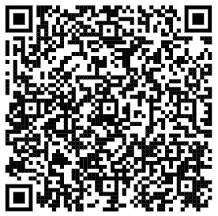
Thank You
Partners
Contact
Md Shafiqul Islam
shafiqul.islam@bth.se
+46734223544
Public report

