Slide 1
What do you think when you hear about a small local museum?

Slide 2
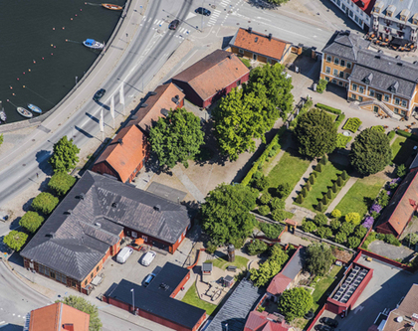
How not Toulouse
Enzo Seiholm
Julian Dambielle
Kevin Hallberg
Kevin Sandström

Slide 3
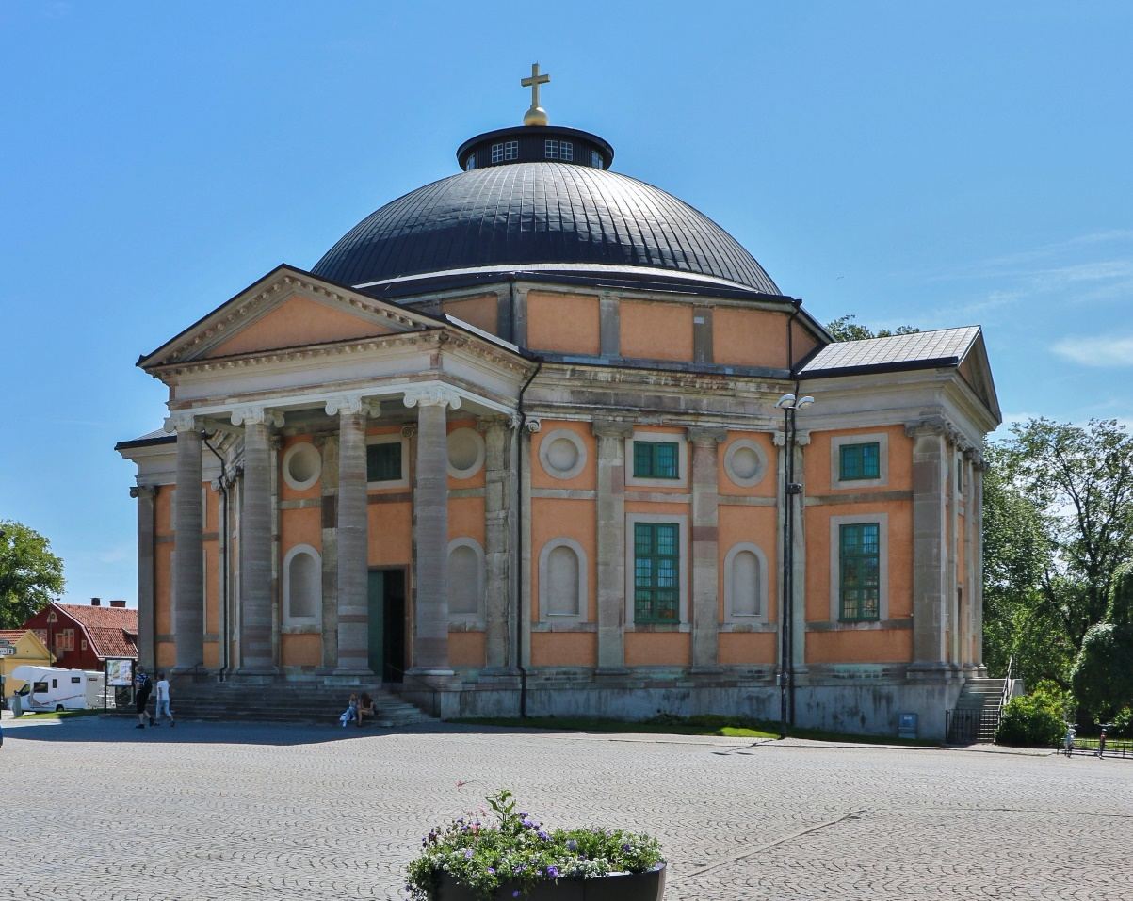
Blekinge World Heritage
Kungsholms Slott
Trefaldighetskyrkan

Slide 4
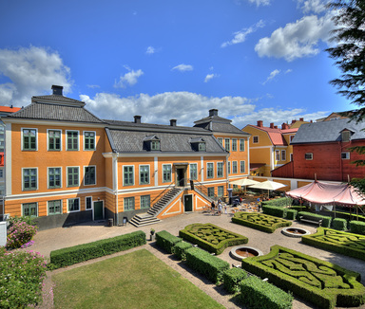
Gathering Information
Museum visit
Interviews
Needfinding Online
Personas

Slide 5
Data gathered

Slide 6
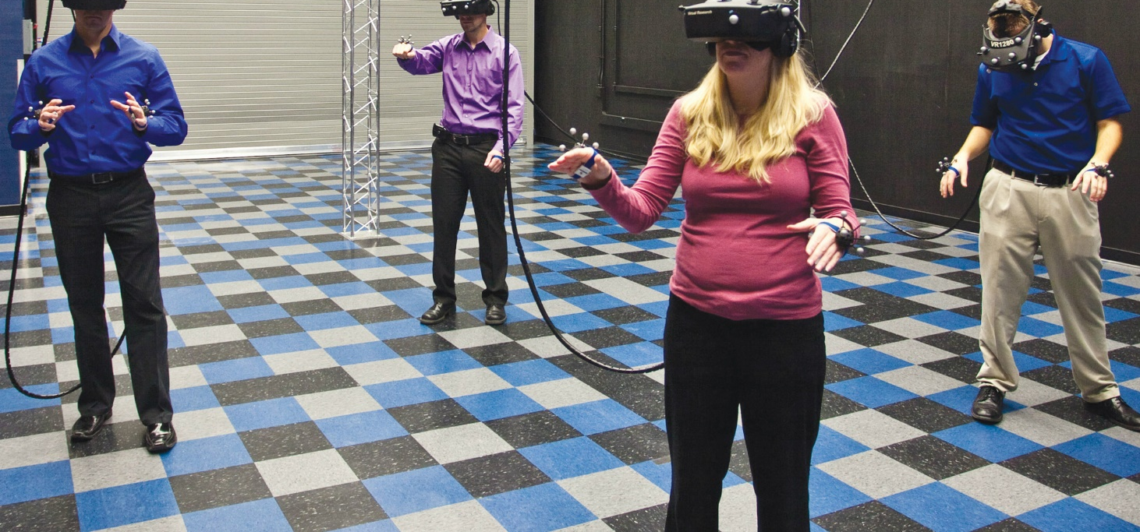
Solution(s)
An interactive journey in 17th century Karlskrona

Slide 7
Restaurant

Slide 8
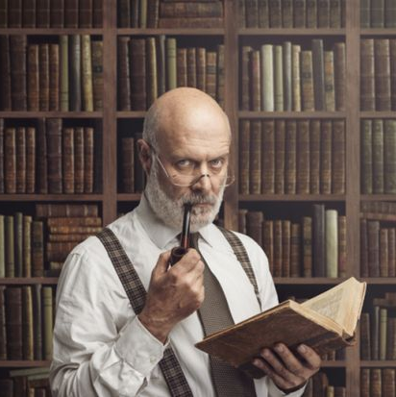
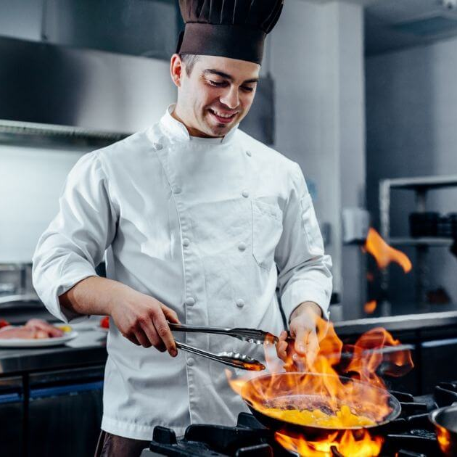
What do we need to do ?

Slide 10
Questions?
This Photo by Unknown author is licensed under CC BY-NC.

